Slide 1
MODULE 6
TCP/IP Protocol Suite

Slide 2

Chapter 15
Transmission
Control
Protocol
(TCP)
TCP/IP Protocol Suite
Copyright © The McGraw-Hill Companies, Inc. Permission required for reproduction or display.

Slide 3
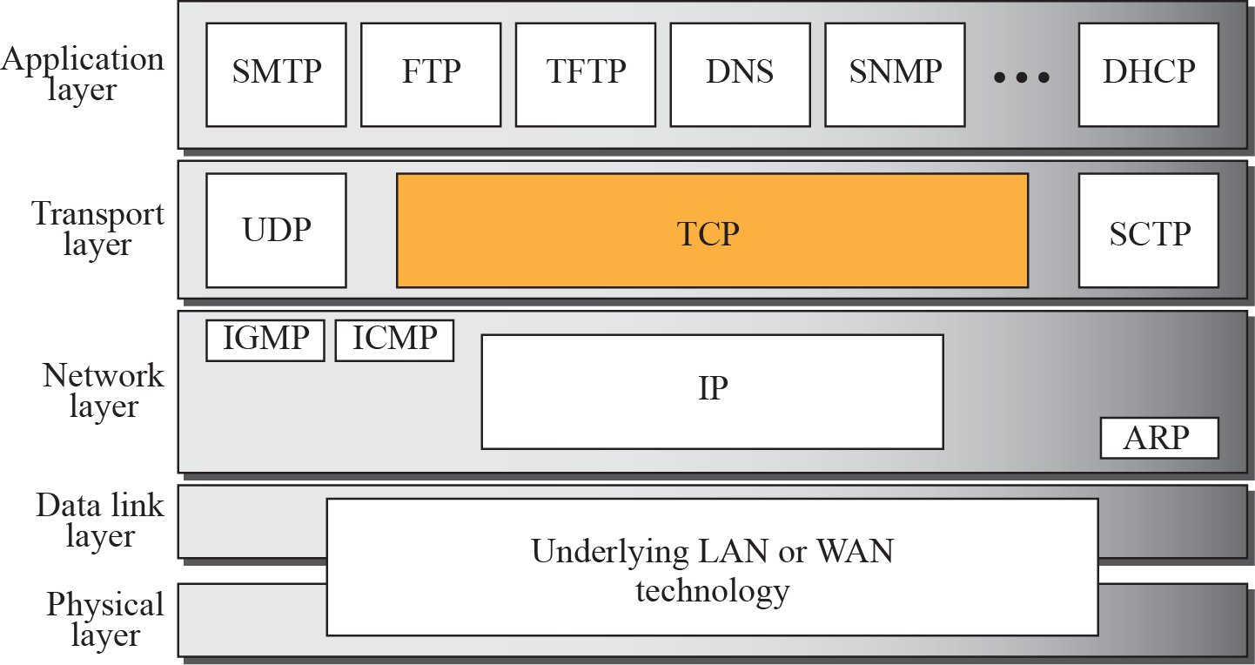
Figure 15.1 TCP/IP protocol suite
TCP/IP Protocol Suite

Slide 4
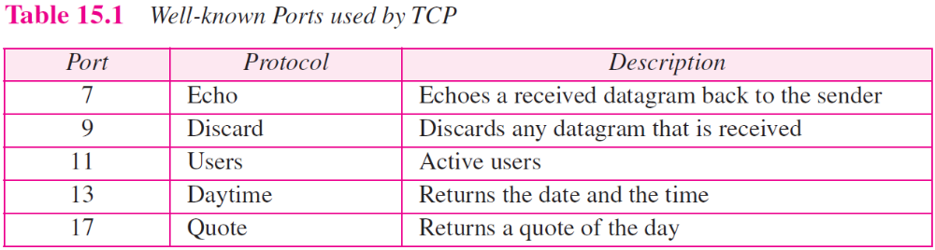
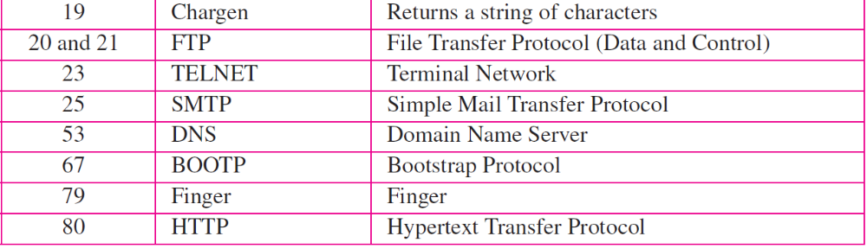
TCP/IP Protocol Suite

Slide 5
TCP Services
Process to process communication
Provides process to process communication using port numbers
2. Stream Delivery Service
Allows the sending process to deliver data as a stream of bytes and allows the receiving process to obtain data as a stream of bytes.
Two processes seem to be connected by an imaginary "tube" that carries their data across the Internet.
TCP/IP Protocol Suite

Slide 6
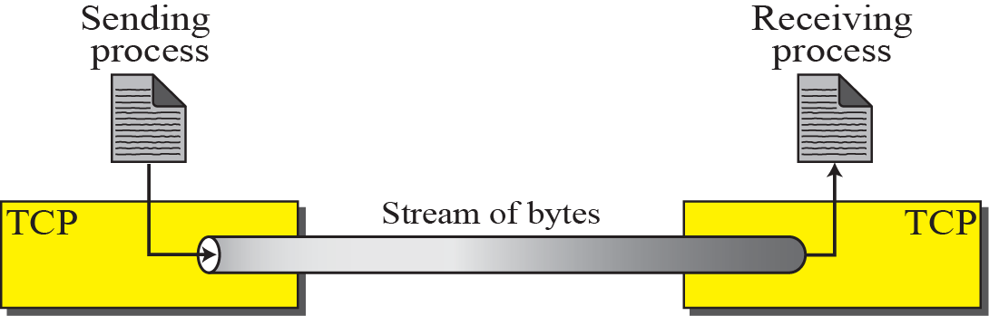
Figure 15.2 Stream delivery
TCP/IP Protocol Suite

Slide 7
3. Sending and Receiving Buffers
The sending and the receiving processes may not write or read data at the same speed, TCP needs buffers for storage.
One way to implement a buffer is to use a circular array of 1-byte locations.
At the sending site, the buffer has three types of chambers:
  1. The white section contains empty chambers that can be filled by the sending process (producer).
  2. Colored area holds bytes that have been sent but not yet acknowledged.
  TCP keeps these bytes in the buffer until it receives an acknowledgment.
  3. The grey area contains bytes to be sent by the sending TCP.
After the bytes in the colored chambers are acknowledged, the chambers are recycled and available for use by the sending process.
TCP/IP Protocol Suite

Slide 8
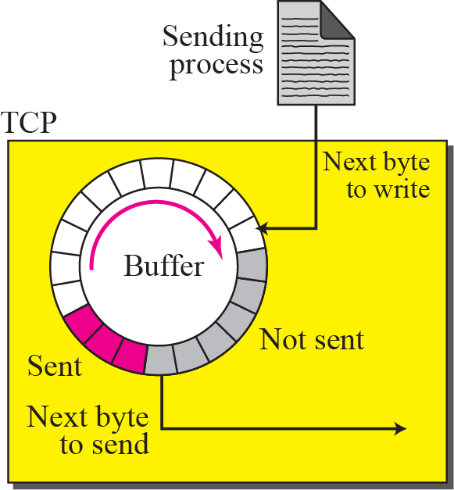
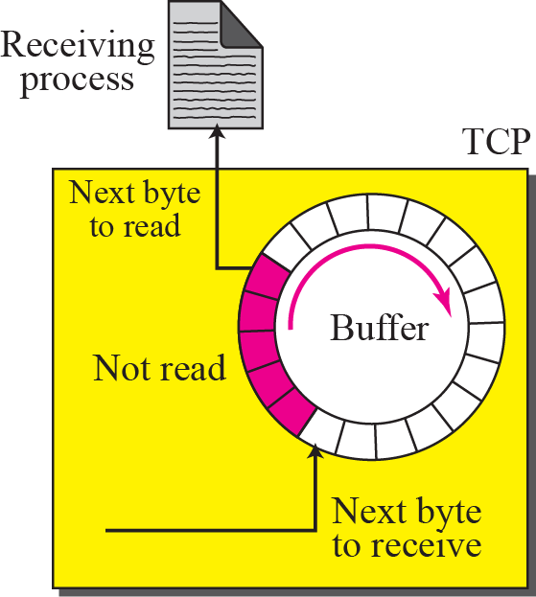
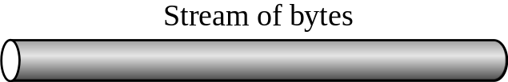
Figure 15.3 Sending and receiving buffers
TCP/IP Protocol Suite

Slide 9
At the receiving site, the operation of the buffer at the receiver site is simpler.
The circular buffer is divided into two areas (shown as white and colored):
  1. The white area contains empty chambers to be filled by bytes received from the network.
  2. The colored sections contain received bytes that can be read by the receiving process.
When a byte is read by the receiving process, the chamber is recycled and added to the pool of empty chambers.
TCP/IP Protocol Suite

Slide 10
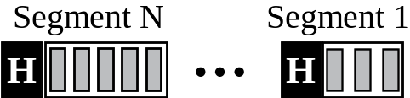
Figure 15.4 TCP segments
TCP/IP Protocol Suite

Slide 11
4. TCP Segments
The IP layer, as a service provider for TCP, needs to send data in packets, not as a stream of bytes.
At the transport layer, TCP groups a number of bytes together into a packet called a segment.
TCP adds a header to each segment (for control purposes) and delivers the segment to the IP layer for transmission.
The segments are encapsulated in IP datagrams and transmitted.
The segments may be received out of order, lost, or corrupted and resent.
All these are handled by TCP with the receiving process unaware of any activities.
TCP/IP Protocol Suite

Slide 12
5. Full-Duplex Communication:
TCP offers full-duplex service, in which data can flow in both directions at the same time.
6. Reliable Service
TCP is a reliable transport protocol.
It uses an acknowledgment mechanism to check the safe and sound arrival of data.
TCP/IP Protocol Suite

Slide 13
15-2 TCP FEATURES
To provide the services mentioned in the previous section, TCP has several features that are briefly summarized in this section and discussed later in detail.
TCP/IP Protocol Suite

Slide 14
Numbering System
Flow Control
Error Control
Congestion Control
TCP/IP Protocol Suite

Slide 15

Note
The bytes of data being transferred in each connection are numbered by TCP.
The numbering starts with an arbitrarily generated number.
TCP/IP Protocol Suite

Slide 16
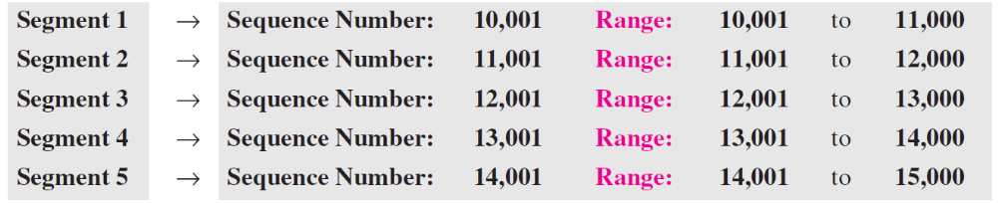
Example 15.1
Suppose a TCP connection is transferring a file of 5,000 bytes. The first byte is numbered 10,001. What are the sequence numbers for each segment if data are sent in five segments, each carrying 1,000 bytes?
Solution
The following shows the sequence number for each segment:
TCP/IP Protocol Suite

Slide 17
Note
The value in the sequence number
field of a segment defines the number assigned to the first data byte
contained in that segment.
TCP/IP Protocol Suite

Slide 18
Note
The value of the acknowledgment field in a segment defines the number of the next byte a party expects to receive.
The acknowledgment number is cumulative.
TCP/IP Protocol Suite

Slide 19
15-3 SEGMENT
Before discussing TCP in more detail, let us discuss the TCP packets themselves. A packet in TCP is called a segment.
TCP/IP Protocol Suite

Slide 20
Topics Discussed in the Section
Format
Encapsulation
TCP/IP Protocol Suite

Slide 21
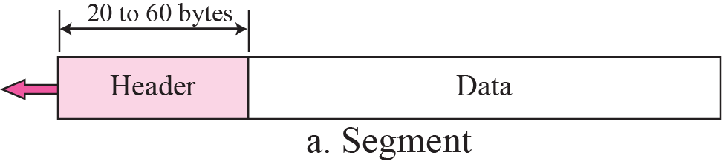
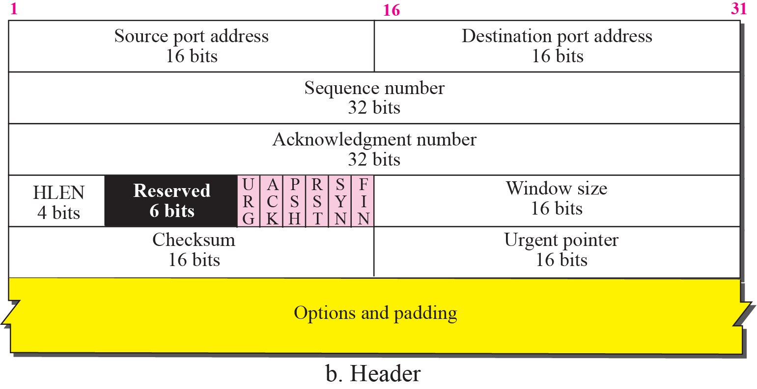
Figure 15.5 TCP segment format
TCP/IP Protocol Suite

Slide 22
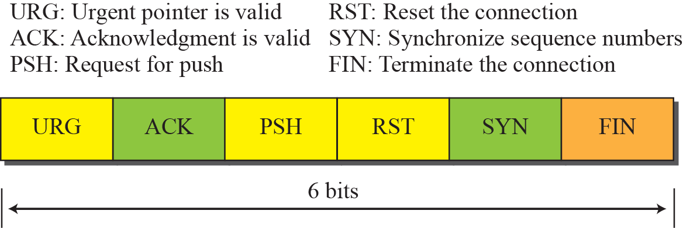
Figure 15.6 Control field
TCP/IP Protocol Suite

Slide 23
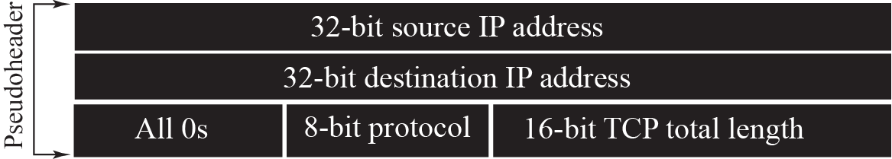
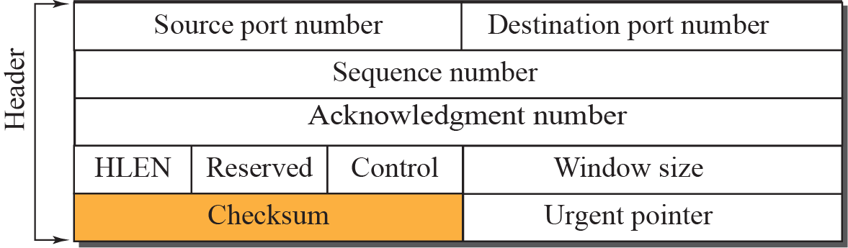

Figure 15.7 Pseudoheader added to the TCP segment
TCP/IP Protocol Suite

Slide 24
Note
The use of the checksum in TCP is mandatory.
TCP/IP Protocol Suite

Slide 25
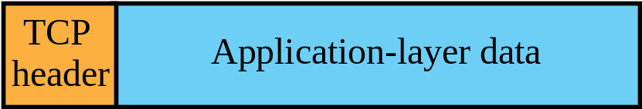
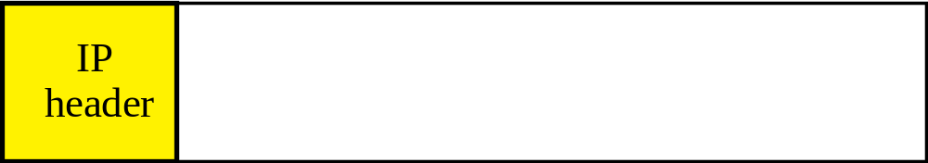
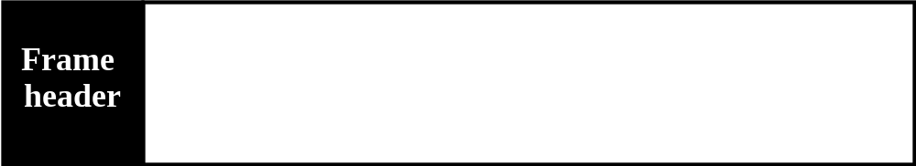
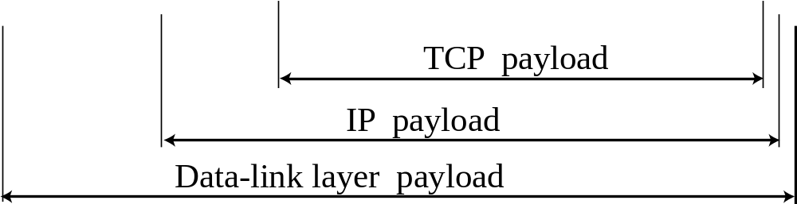
Figure 15.8 Encapsulation
TCP/IP Protocol Suite

Slide 26
15-4 A TCP CONNECTION
TCP is connection-oriented.
It establishes a virtual path between the source and destination.
All of the segments belonging to a message are then sent over this virtual path.
a TCP connection is virtual, not physical.
TCP/IP Protocol Suite

Slide 27
(TCP) Connection oriented transmission require
3 phases
Connection Establishment
Data Transfer
Connection Termination
TCP/IP Protocol Suite

Slide 28
1. Connection Establishment
To establish a connection, TCP uses a three-way handshaking.
Based on client-server paradigm.
Process starts with the server.
The server program tells its TCP that it is ready to accept a connection, this is called a request for passive open.
The client program issues a request for an active open.
A client that wishes to connect to an open server tells its TCP that it needs to be connected to that particular server.
TCP can now start the 3 way hand shaking.
TCP/IP Protocol Suite

Slide 29
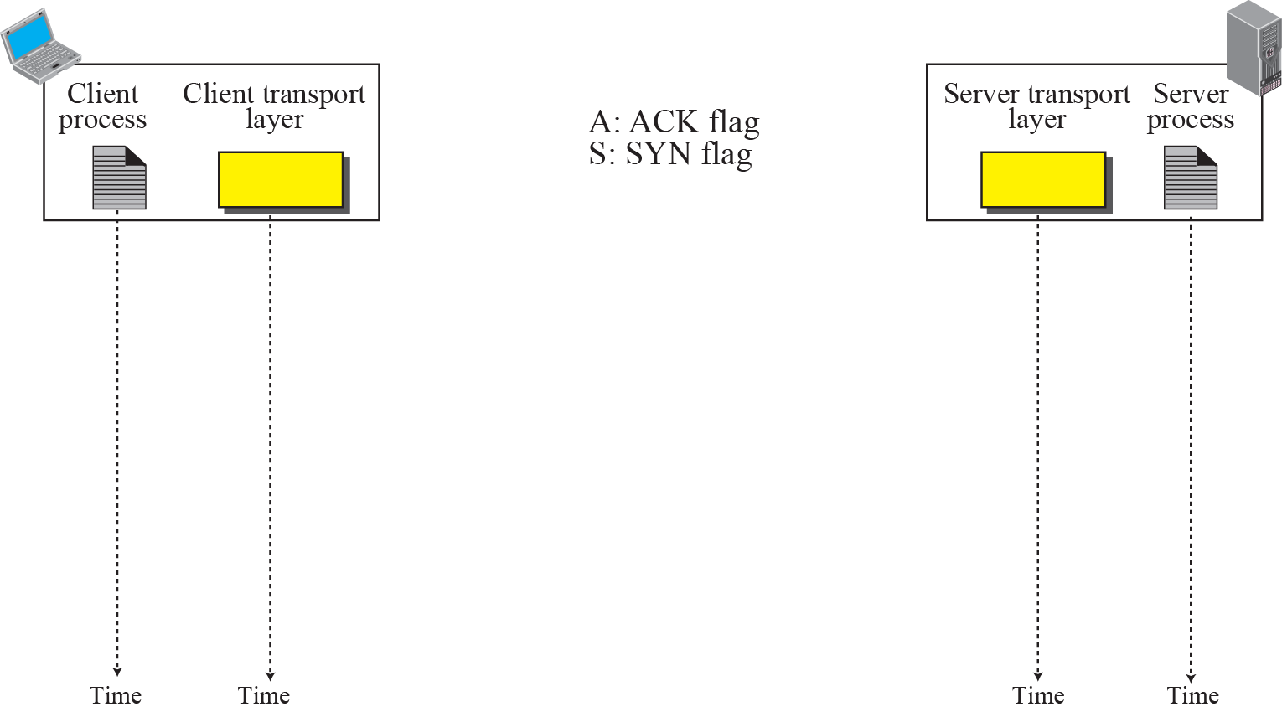


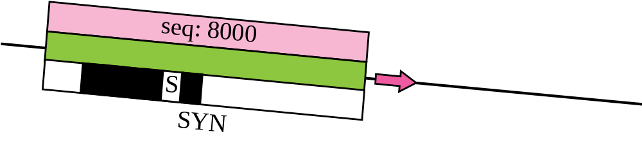
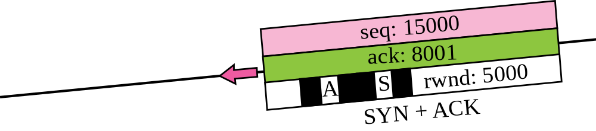
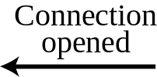
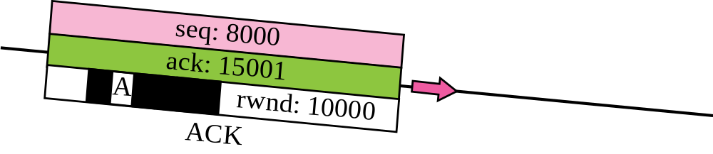

Figure 15.9 Connection establishment using three-way handshake
Means “no data” !
seq: 8001 if piggybacking
TCP/IP Protocol Suite

Slide 30
Note
A SYN segment cannot carry data, but it consumes one sequence number.
TCP/IP Protocol Suite

Slide 31
Note
A SYN + ACK segment cannot carry data, but does consume one
sequence number.
TCP/IP Protocol Suite

Slide 32
Note
An ACK segment, if carrying no data, consumes no sequence number.
TCP/IP Protocol Suite

Slide 33
SYN Flooding Attack
In a TCP SYN flooding DoS attack, an attacker sends out many SYN messages with
forged IP addresses.
The server replies with SYN/ACK messages, but the attacker never acknowledges these messages, thereby leaving many half-open connections on the server.
The intruder can continue sending SYN messages until the server reaches its
half-open-connection limit and can’t respond to any new incoming requests.
Preventive measures
Impose limit on connection request during specified time period.
Postpone resource allocation until the entire connection is set up.
TCP/IP Protocol Suite

Slide 34
2. Data Transfer
After connection established, bidirectional data transfer can take place.
Client and server can send both acknowledgement and data.
TCP/IP Protocol Suite

Slide 35
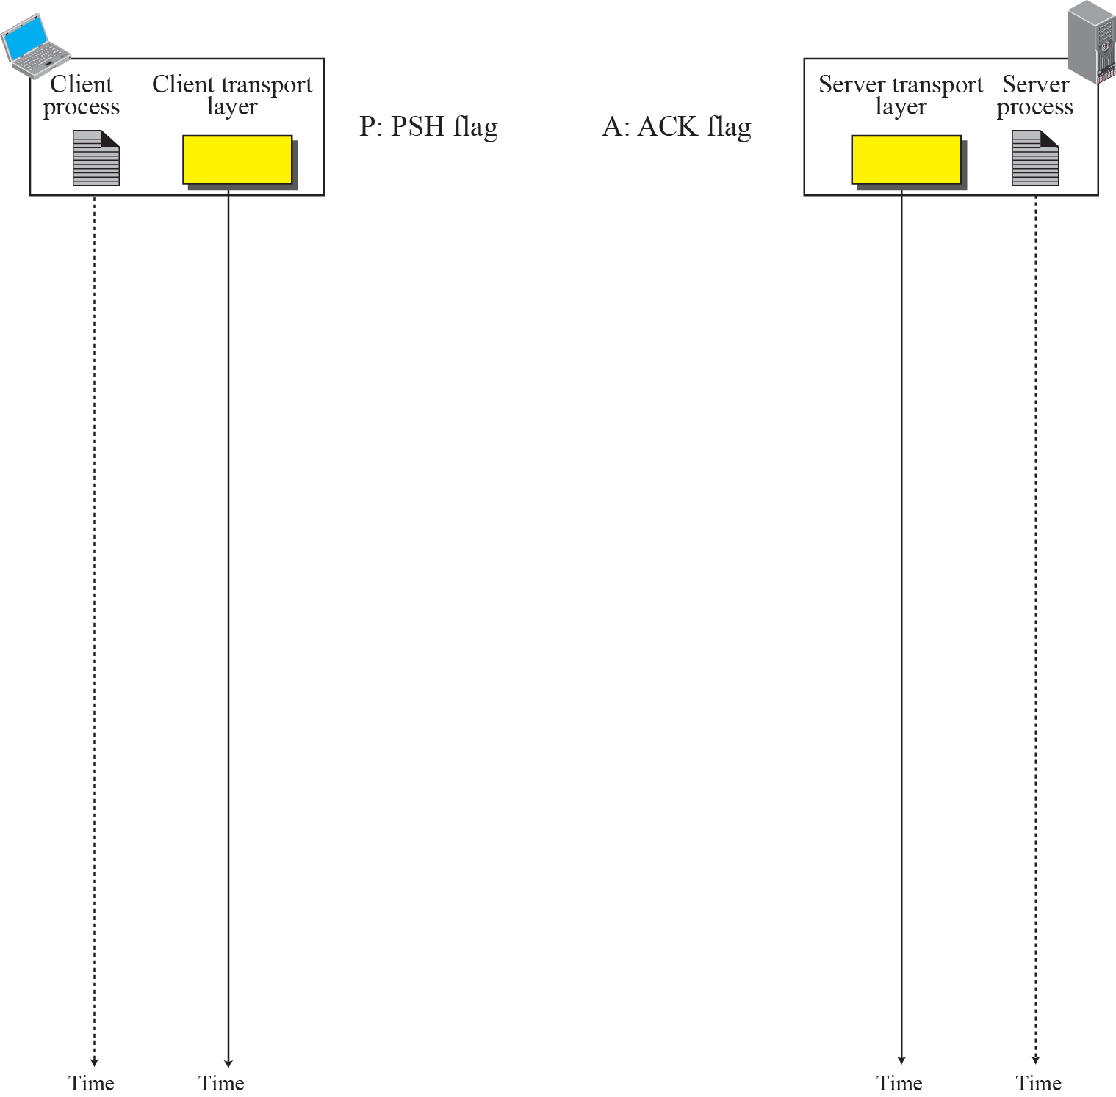
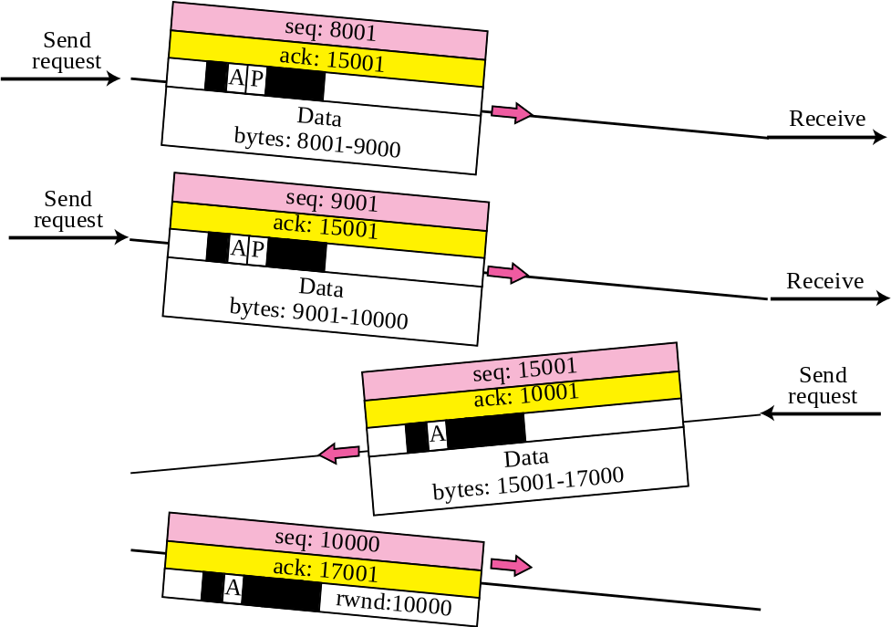

Figure 15.10 Data Transfer
Pushing data
Urgent data
TCP/IP Protocol Suite

Slide 36
Pushing data:
    Push bit set.
    This means the sending TCP must not wait for the window to be filled.
    It must create a segment and send data immediately.
    Receiving TCP knows that the segment includes data that must be delivered to the receiving application program as soon as possible.
Urgent Data:
  The sending application program wants a piece of data to be read out of order by the receiving application program.
  The sending TCP creates a segment and inserts urgent data at the beginning of the segment.
  URG bit set at header.
  The urgent pointer in the header defines the end of urgent data and start of normal data.
TCP/IP Protocol Suite

Slide 37
3. Connection Termination
TCP/IP Protocol Suite

Slide 38
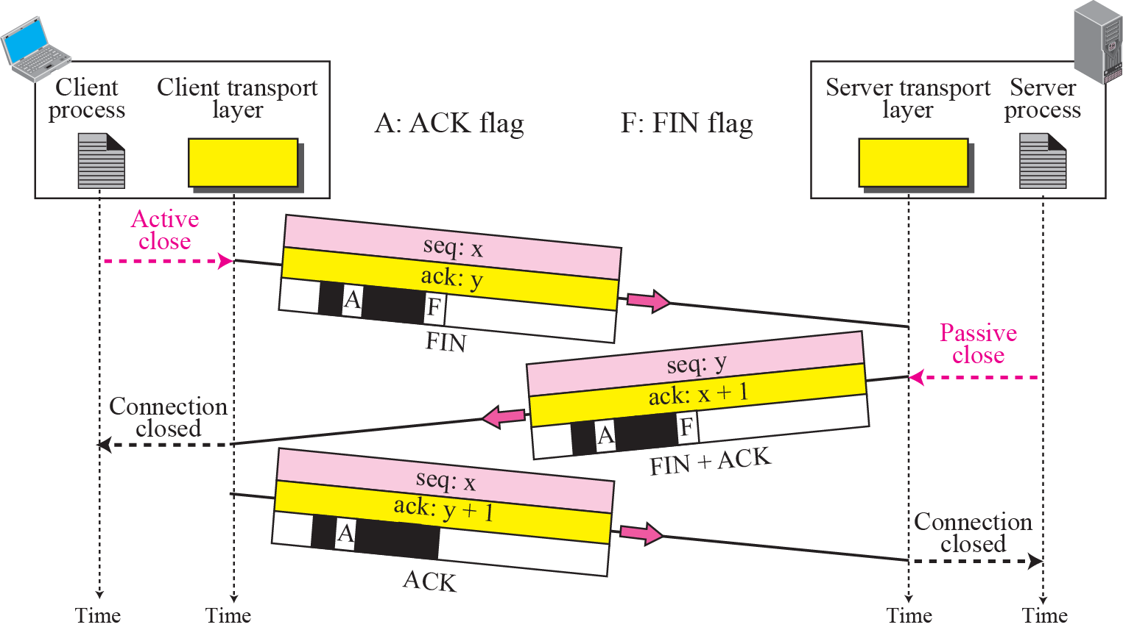
Connection termination using three-way handshake
TCP/IP Protocol Suite

Slide 39
Note
The FIN segment consumes one sequence number if it does
not carry data.
TCP/IP Protocol Suite

Slide 40
Note
The FIN + ACK segment consumes one sequence number if it does
not carry data.
TCP/IP Protocol Suite

Slide 41
Half Close
One end can stop sending data while still receiving data, this is call half closed.
Normally initiated by client.
TCP/IP Protocol Suite

Slide 42
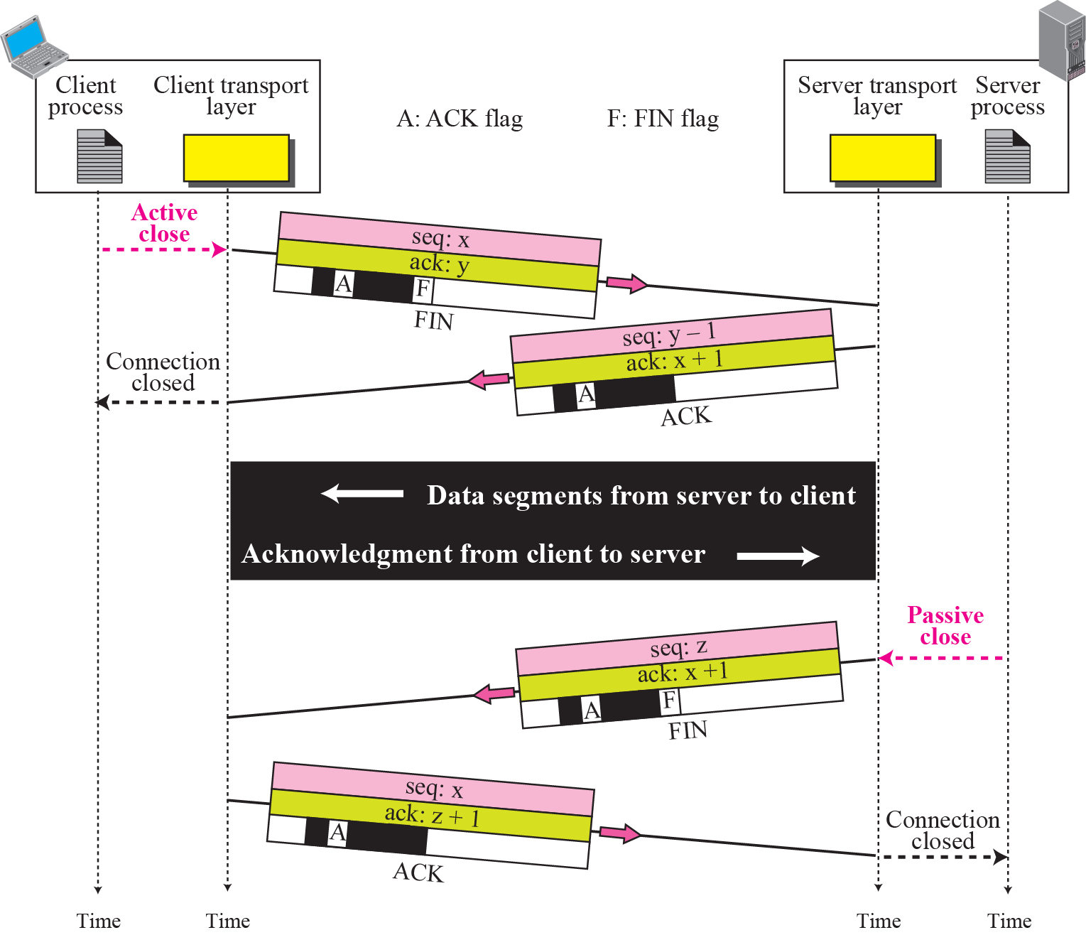
Half-Close
TCP/IP Protocol Suite

Slide 43
15-5 STATE TRANSITION DIAGRAM
To keep track of all the different events happening during connection establishment, connection termination, and data transfer, TCP is specified as the finite state machine shown in Figure 15.13.
TCP/IP Protocol Suite

Slide 44
Topics Discussed in the Section
Scenarios
TCP/IP Protocol Suite

Slide 45
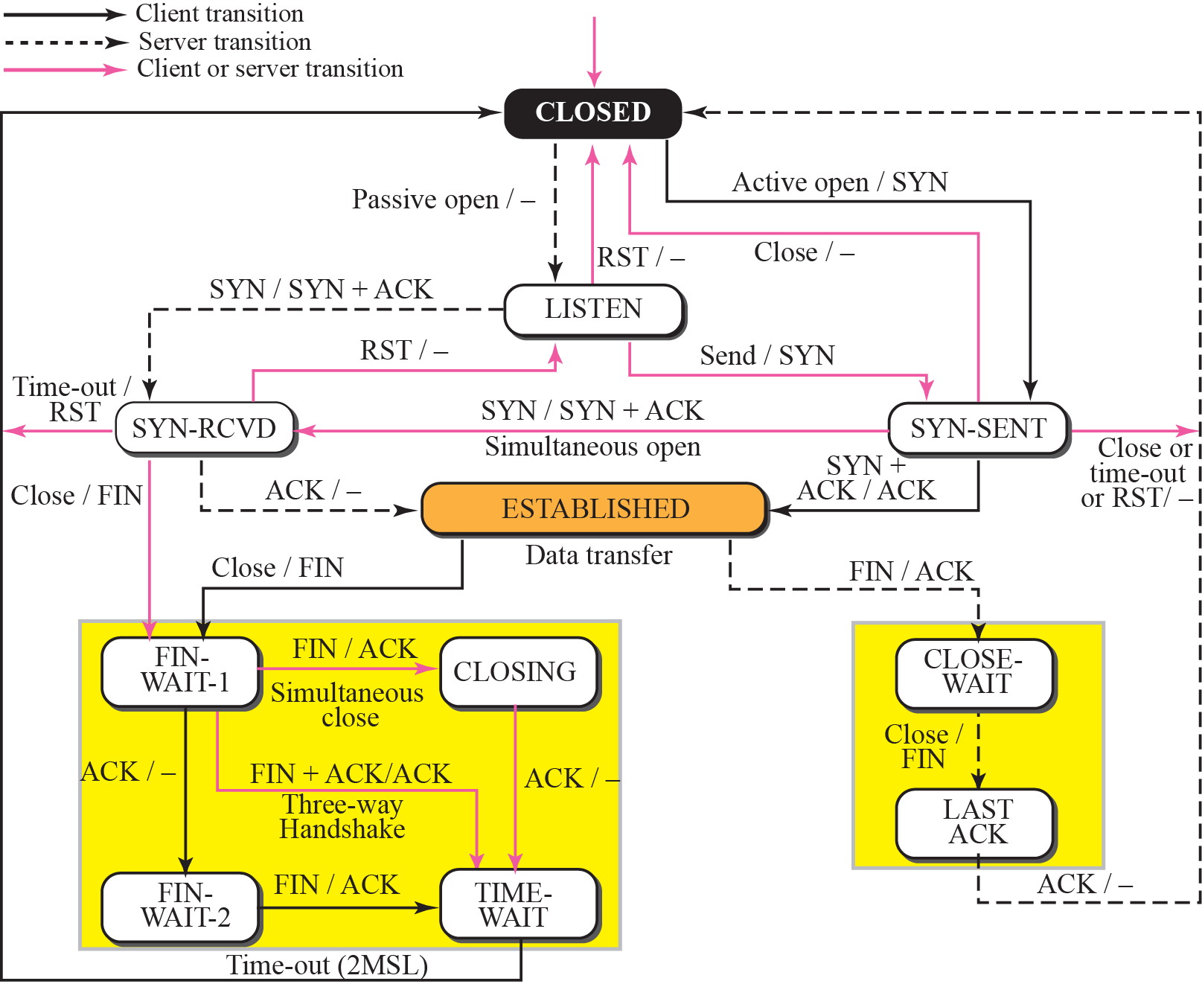
Figure 15.13 State transition diagram
TCP/IP Protocol Suite

Slide 46
Note
The state marked as ESTBLISHED
in the FSM is in fact two different
sets of states that the client
and server undergo to transfer data.
TCP/IP Protocol Suite

Slide 47
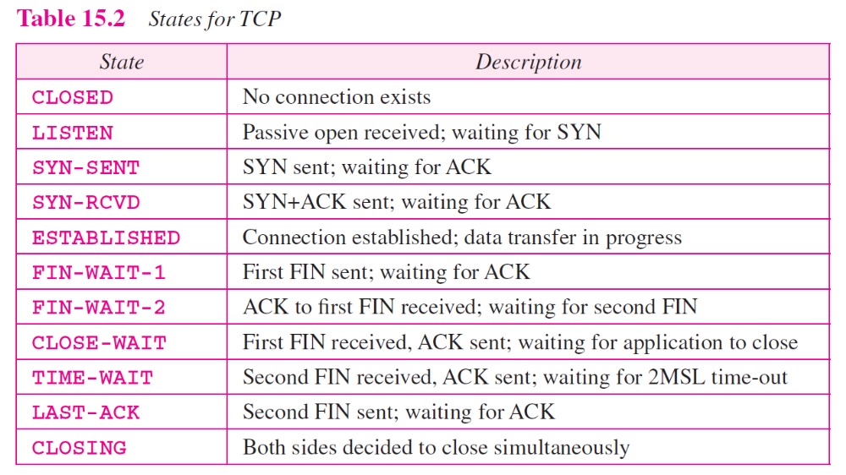
TCP/IP Protocol Suite

Slide 48
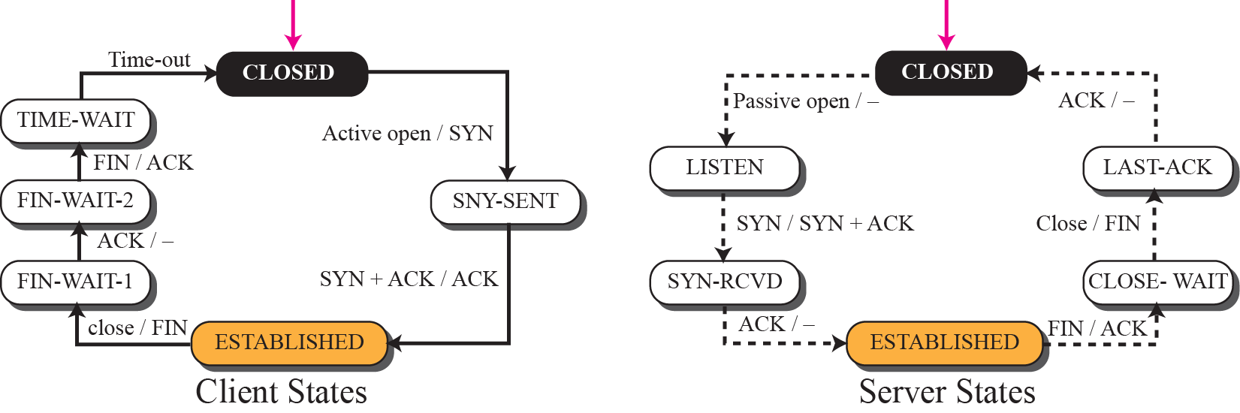
Figure 15.14 Transition diagram for connection and half-close termination
TCP/IP Protocol Suite

Slide 49
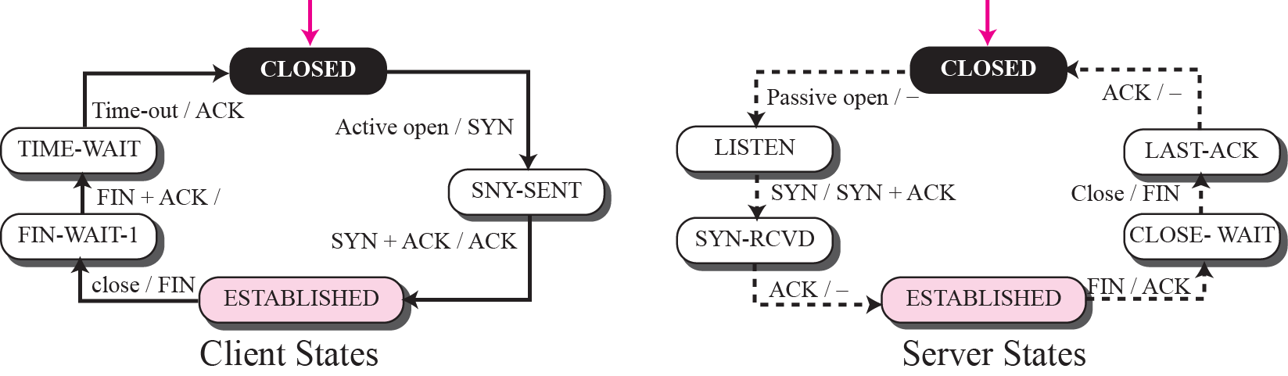
Figure 15.16 Transition diagram for a common scenario
TCP/IP Protocol Suite

Slide 50
15-6 WINDOWS IN TCP
TCP uses two windows (send window and receive window) for each direction of data transfer, which means four windows for a bidirectional communication.
To make the discussion simple, we make an assumption that communication is only unidirectional; the bidirectional communication can be inferred using two unidirectional communications with piggybacking.
TCP/IP Protocol Suite

Slide 51
Topics Discussed in the Section
Send Window
Receive Window
TCP/IP Protocol Suite

Slide 52
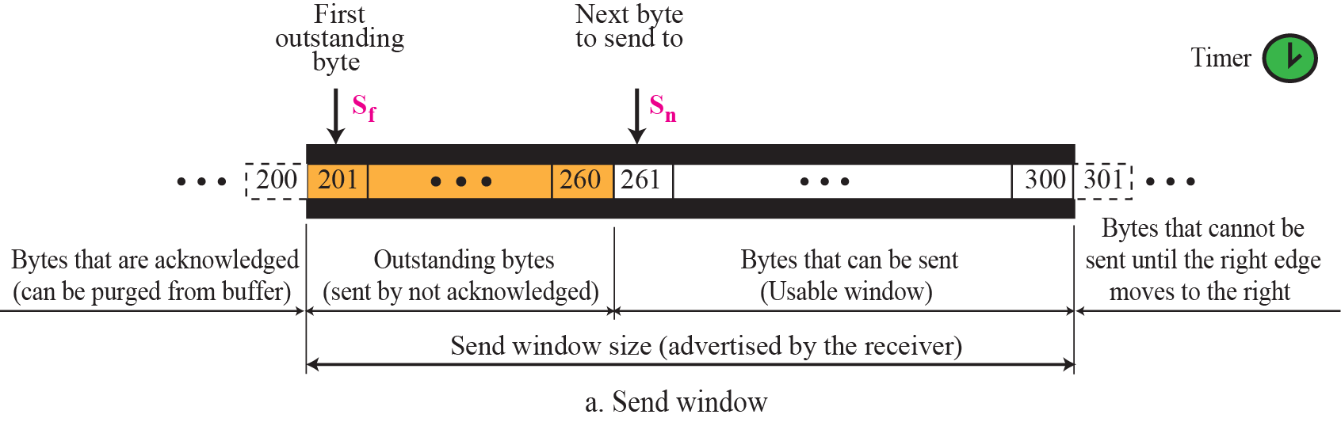
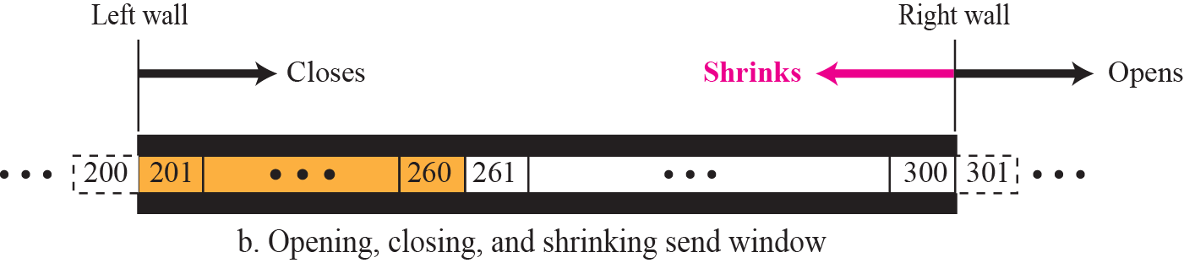
Figure 15.22 Send window in TCP
TCP/IP Protocol Suite

Slide 53
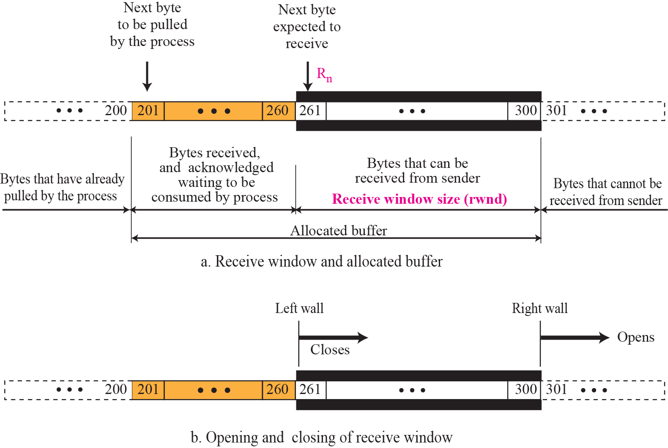
Figure 15.23 Receive window in TCP
TCP/IP Protocol Suite

Slide 54
15-7 FLOW CONTROL
Flow control balances the rate a producer creates data with the rate a consumer can use the data.
TCP separates flow control from error control.
The sliding window protocol used by TCP, is something between GO-Back- N and selective Repeat .
Sliding window of TCP is byte oriented.
TCP/IP Protocol Suite

Slide 55
The window spans a portion of the buffer containing bytes received from
the process.
The window is opened, closed, or shrink.
These activities are in the control of the receiver.
Opening window :
Means moving the right wall to the right.
This allows more new bytes in the buffer that are eligible for sending.
Closing the window:
moving left wall to right.
some bytes have been acknowledged .
shrinking:
moving right wall to the left.
It means revoking the eligibility of some bytes for sending.
Size of the window : minimum(rwindow, cwindow)
Rwindow: receiver window, values advertised by receiver.
Cwindow: congestion window, it’s the value advertised by the network to
avoid congestion.
TCP/IP Protocol Suite

Slide 56
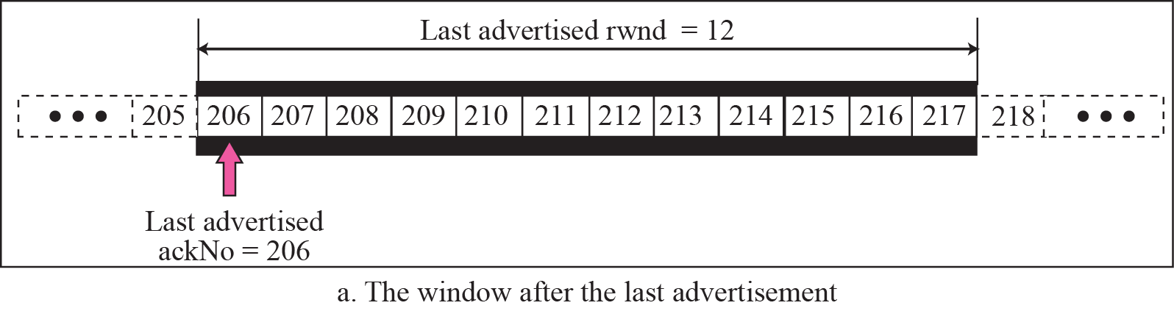
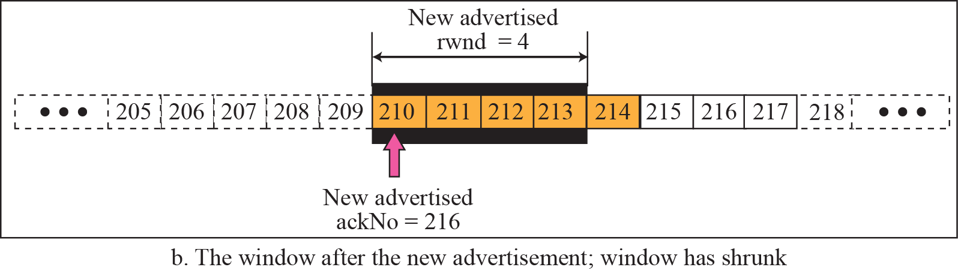
Figure 15.26 Example 15.2
Prevent the shrinking of the send window:
new ackNo + new rwnd >= last ackNo + last rwnd
?
210
TCP/IP Protocol Suite

Slide 57
15-8 ERROR CONTROL
TCP is a reliable transport layer protocol. This means that an application program that delivers a stream of data to TCP relies on TCP to deliver the entire stream to the application program on the other end in order, without error, and without any part lost or duplicated.
Error control in TCP is achieved through the use of three tools: checksum, acknowledgment, and time-out.
TCP/IP Protocol Suite

Slide 58
Checksum :
-used to check for a corrupted segment.
-If the segment is corrupted ,it is discarded by the destination TCP and is considered as lost.
-16 bit checksum
TCP/IP Protocol Suite

Slide 59
Acknowledgement
Note
ACK segments do not consume sequence numbers and
are not acknowledged.
TCP/IP Protocol Suite

Slide 60
Retransmission
The heart of the error control mechanism is the retransmission of segment.
When a segment is corrupted ,lost or delayed it is retransmitted.
Retransmission in two occasions
  Timer expires
  When the sender receives 3 duplicate ACKs.
TCP/IP Protocol Suite

Slide 61
Out of order segment
Note
Data may arrive out of order and be temporarily stored by the receiving TCP,
but TCP guarantees that no out-of-order data are delivered to the process.
TCP/IP Protocol Suite

Slide 62
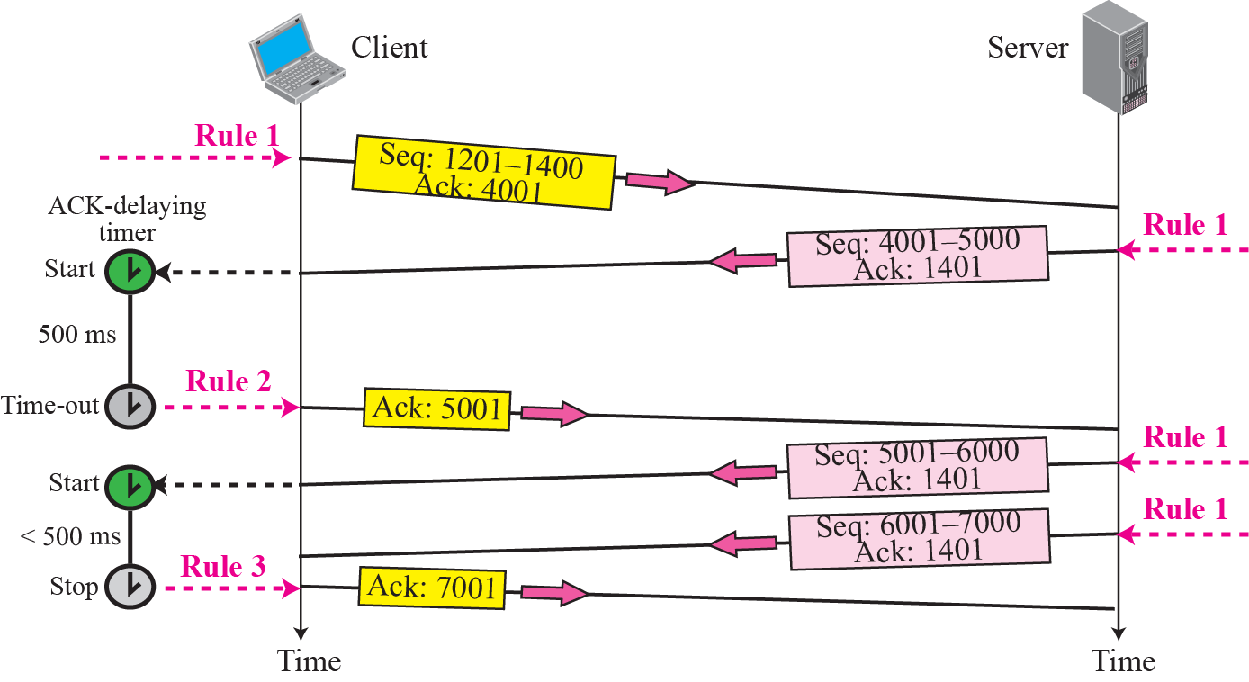
Figure 15.29 Normal operation
TCP/IP Protocol Suite

Slide 63
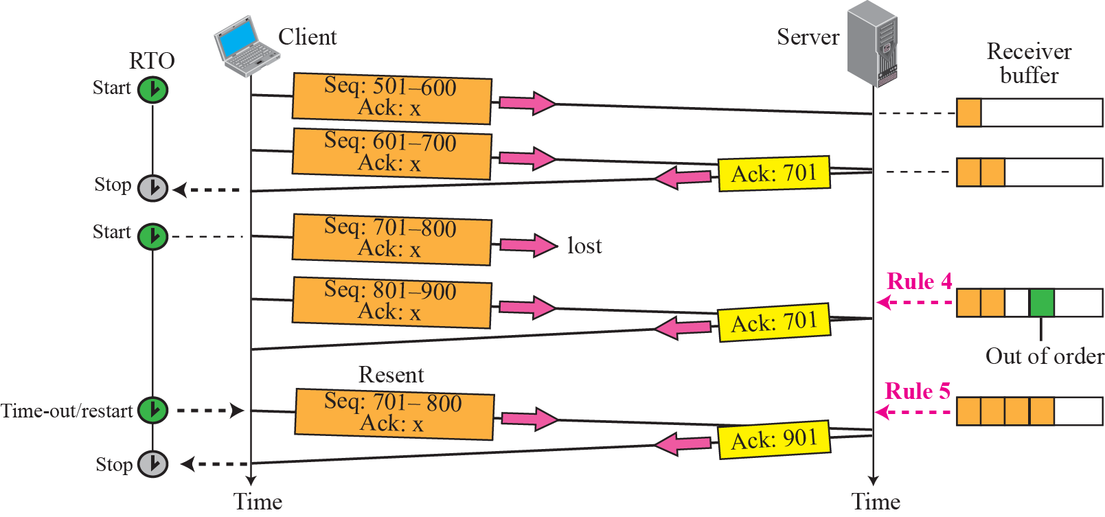
Figure 15.30 Lost segment
TCP/IP Protocol Suite

Slide 64
Note
The receiver TCP delivers only ordered data to the process.
TCP/IP Protocol Suite

Slide 65
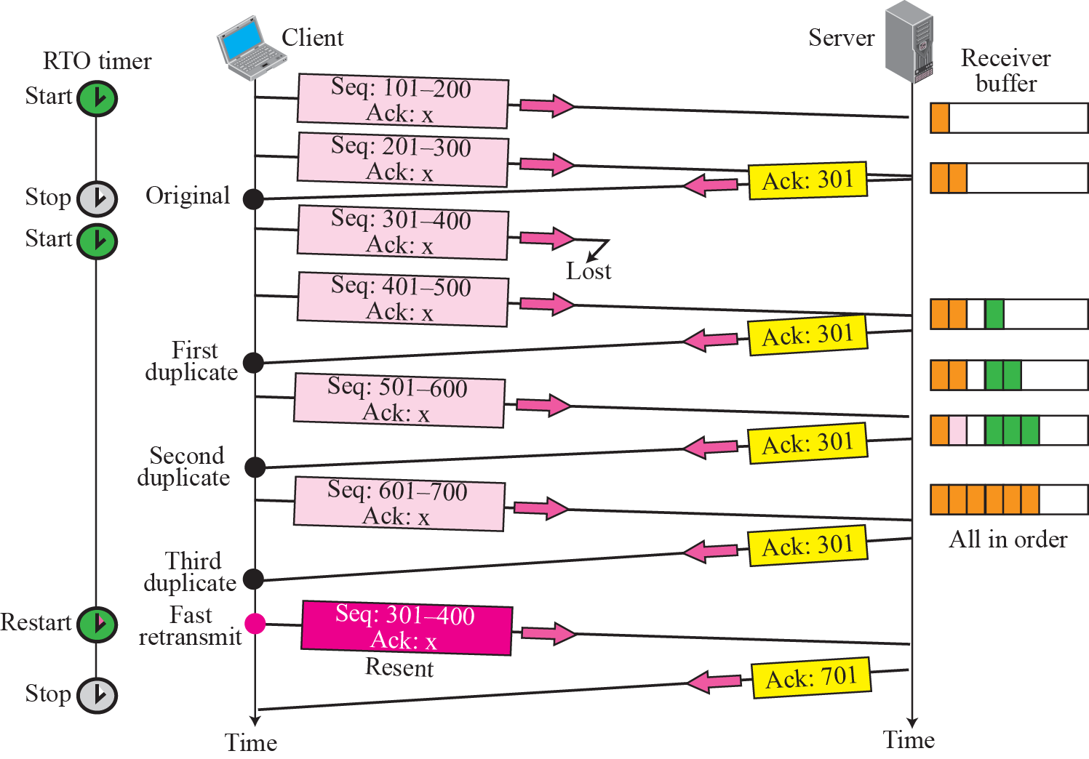





Figure 15.31 Fast retransmission
TCP/IP Protocol Suite

Slide 66
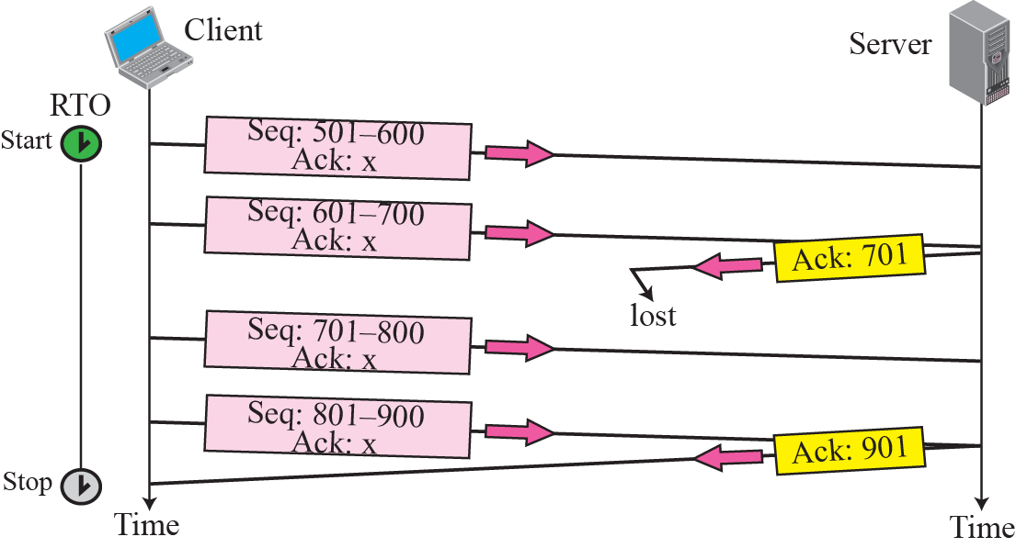
Figure 15.32 Lost acknowledgment
TCP/IP Protocol Suite

Slide 67
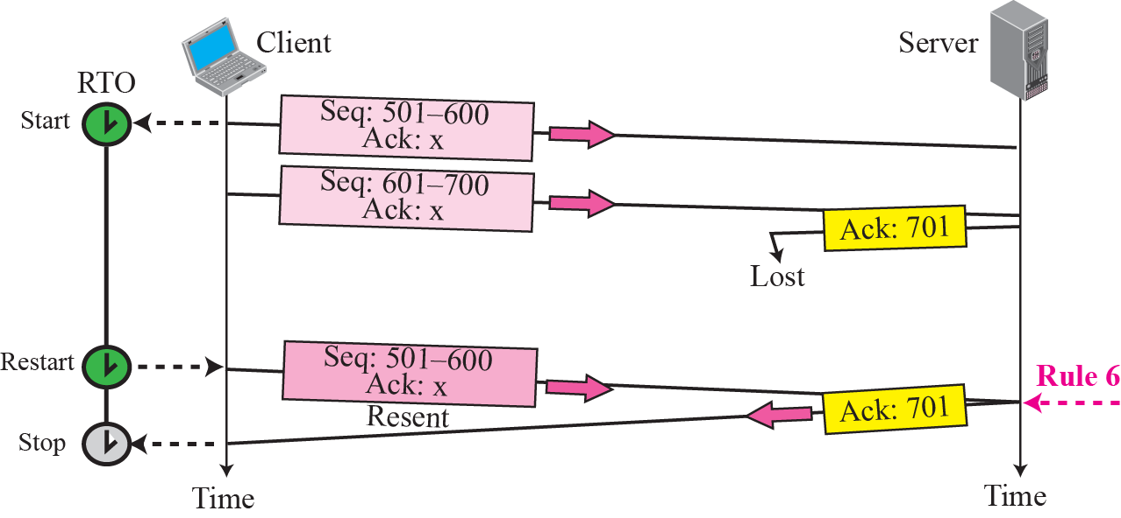
Figure 15.33 Lost acknowledgment corrected by resending a segment
TCP/IP Protocol Suite

